Slide 1
Computer Vision and Image Processing
Trigul 2
Color Spaces
By Shai Aharon & Moriya Bitton

Slide 2
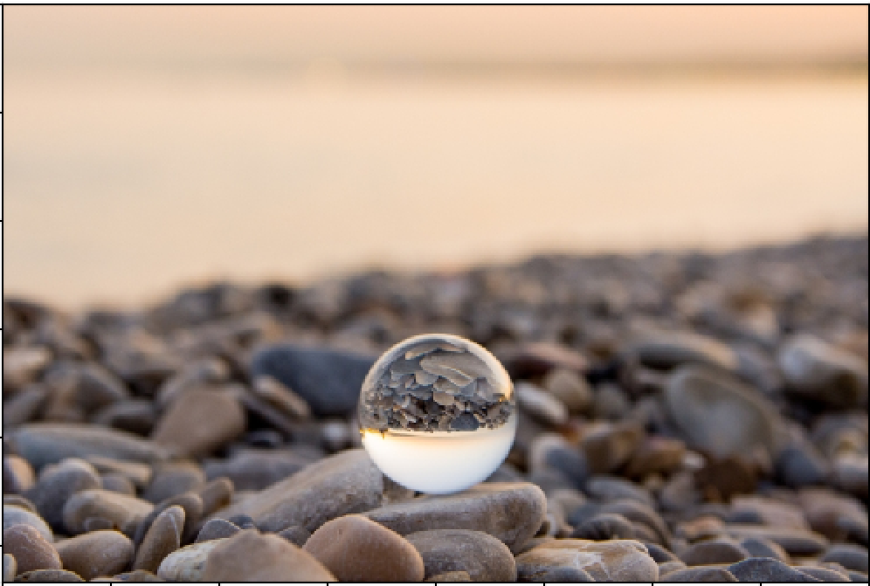
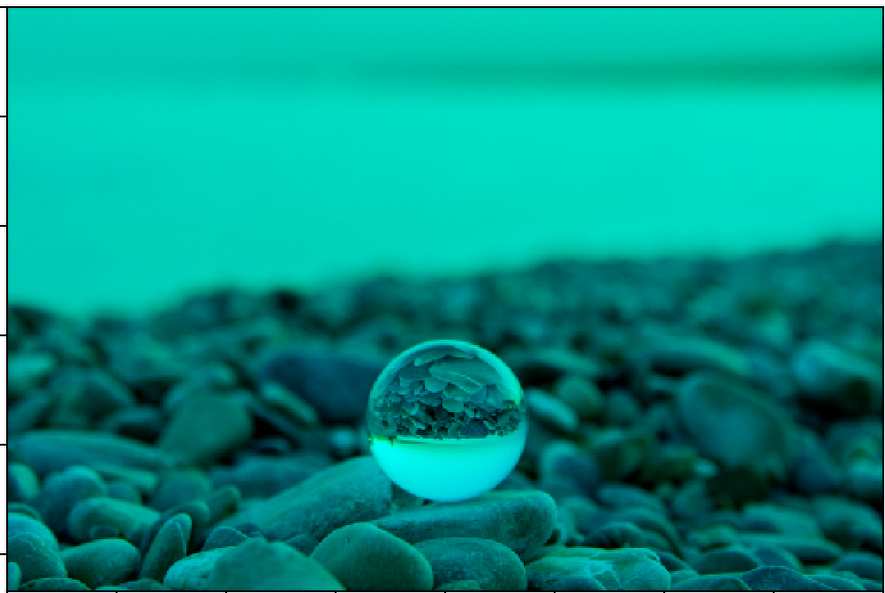
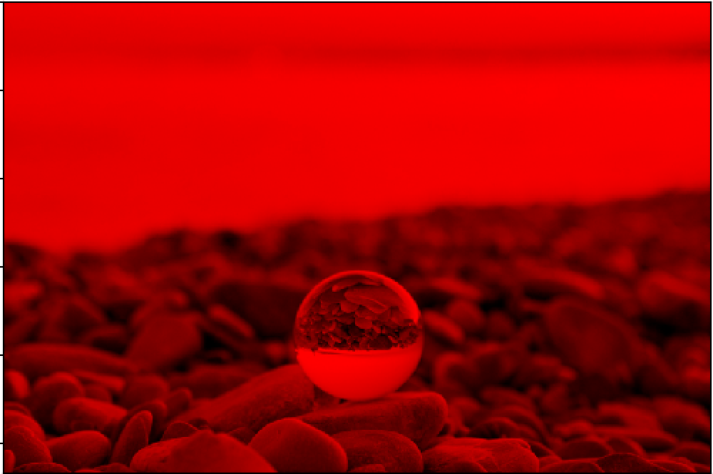
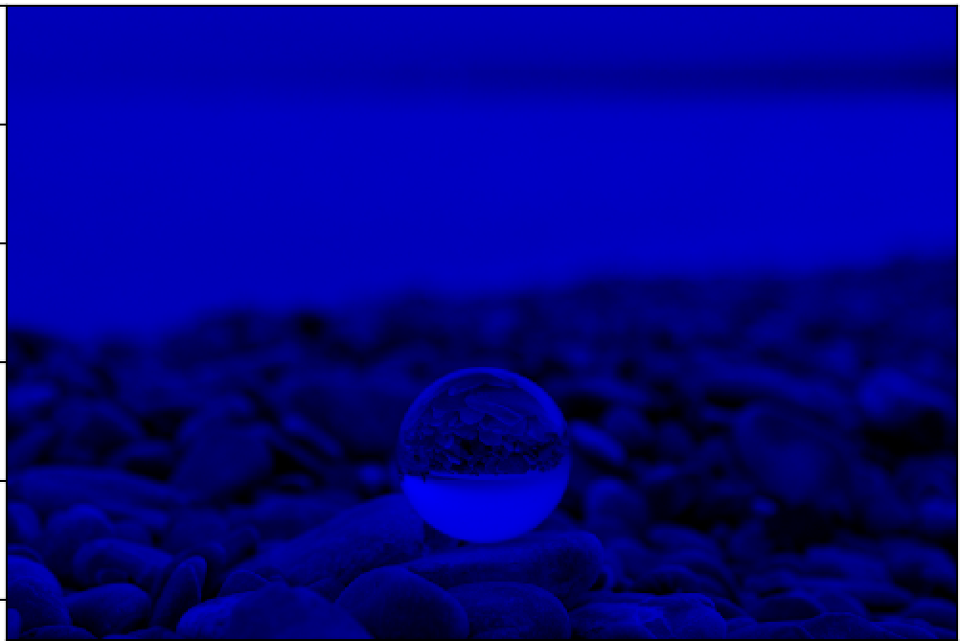
Color spaces
There are a few ways to represent images, the most known is RGB. Each channel contains the intensity levels of one color (Red, Green or Blue)

Slide 3
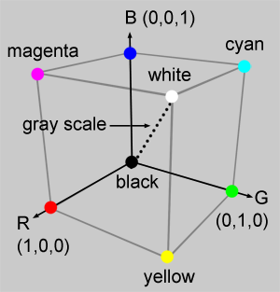

Slide 4
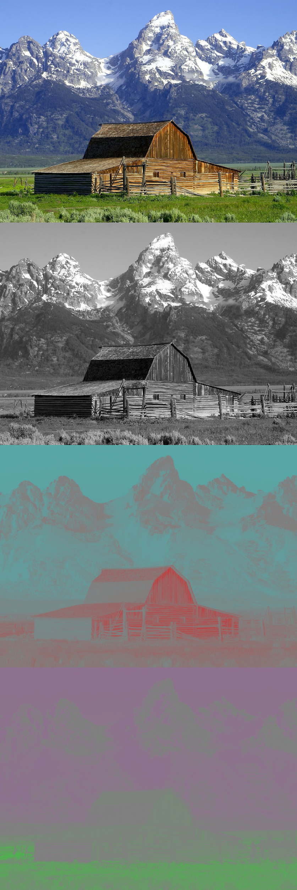
Color spaces
Other color spaces exist, each one has a different use.
YIQ former know as the NTSC color TV system.
The first channel (Y) is the intensity channel (luminance scale). Unlike the RGB, where the intensity is split across (encoded in) all three channels.
The other two contain the chrominance information. I: Orange <-> Blue Q: Purple <-> Green

Slide 5
Color spaces
The I and the Q are roughly orthogonal thus spanning the whole color space
The human visual system is much more sensitive to changes in the I axis than in the Q axis, allowing the Q axis to be transmitted with less fidelity (bits), conserving bandwidth.
This color scheme was used to broadcast to old black & white TV’s and new color TV’s at the same time, the old ones would just use the Y channel, while the new ones combined the other two to get a color image.

Slide 6
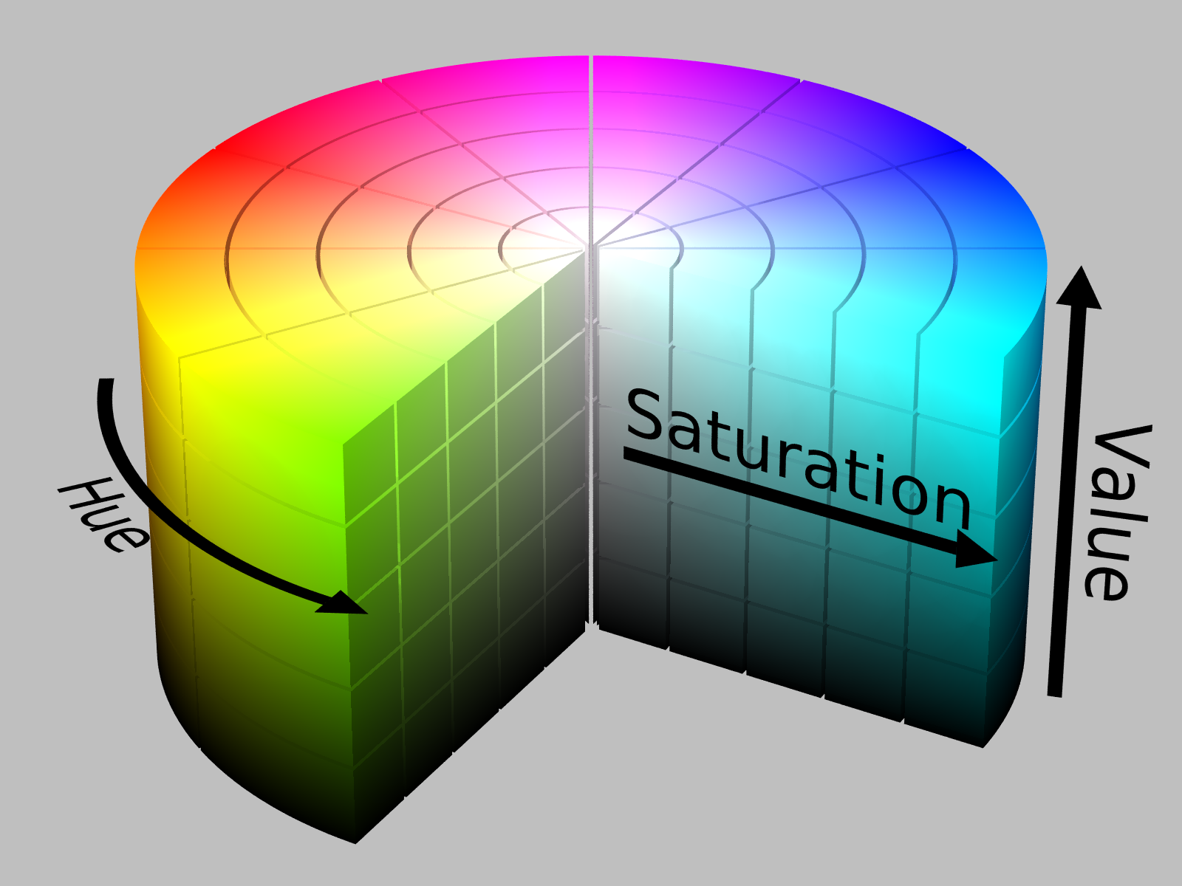
Color spaces
Another common color space is HSV, which stands for: Hue - Color, Range[0,360)
Saturation - Strength of the color, [0,1]
Value - Brightness, [0,1]

Slide 7
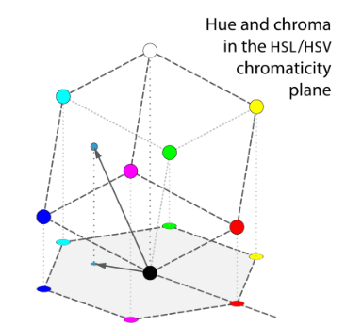
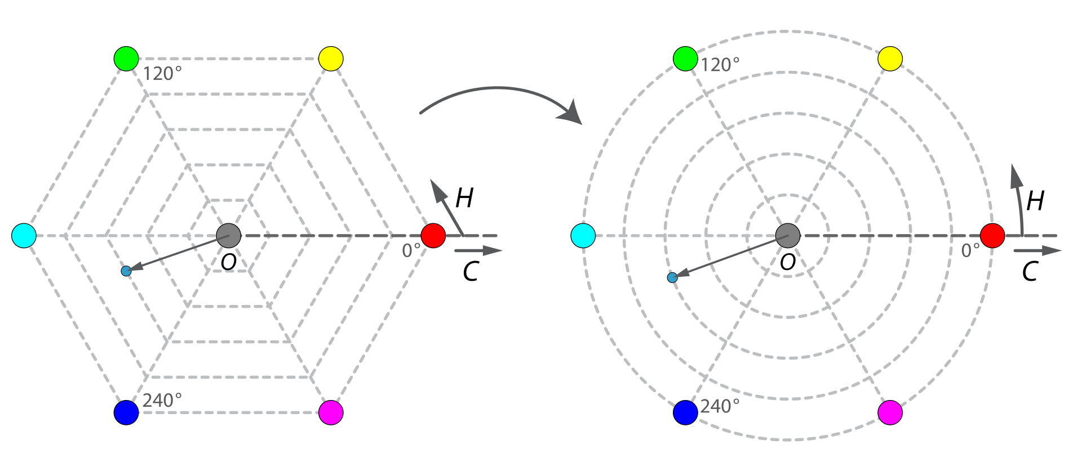
Color spaces

Slide 8
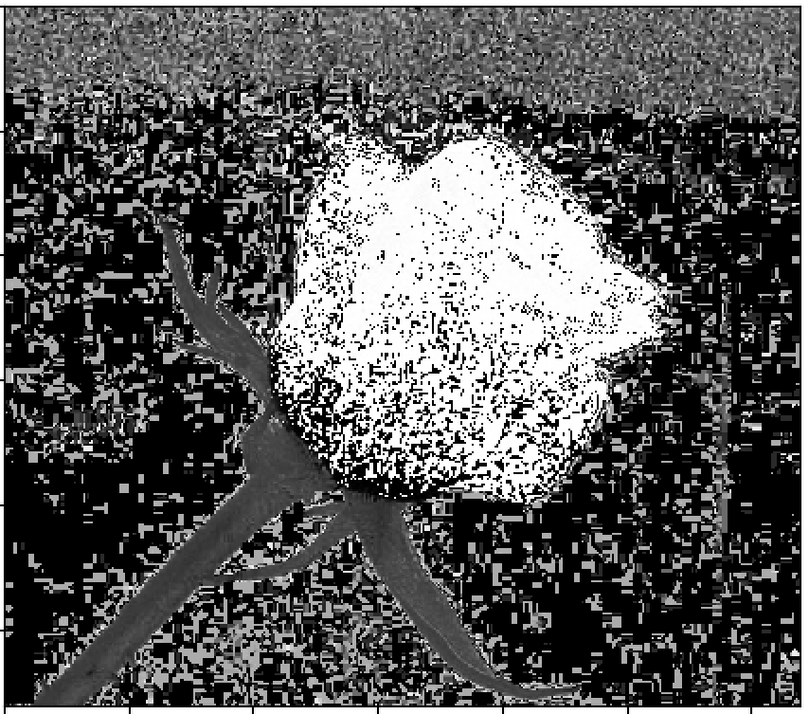
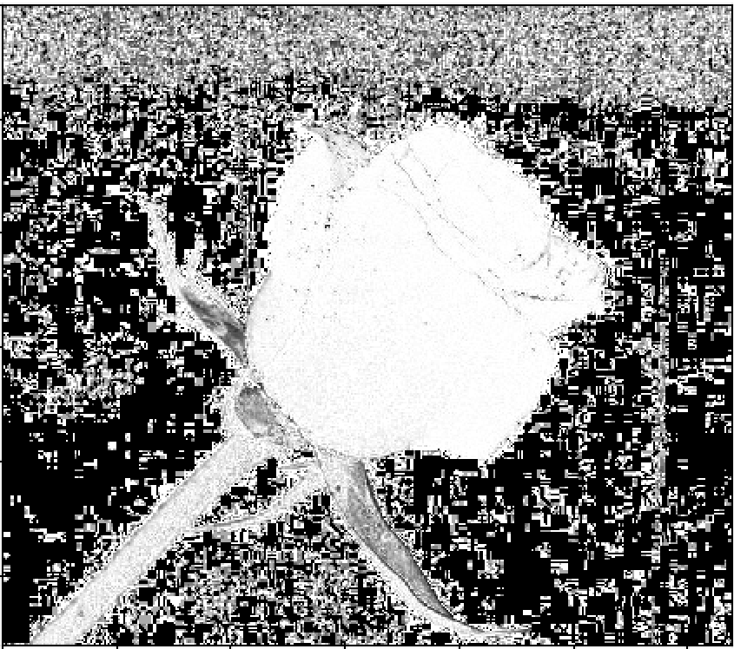
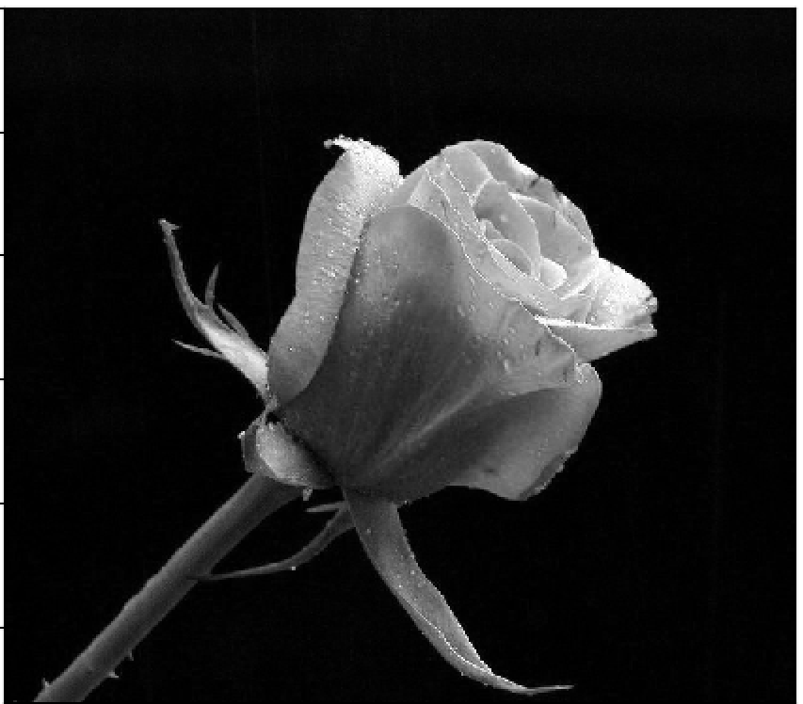
HSV
Hue
Saturation
Value

Slide 9
Color spaces
HSV is very useful for when you need to get pixels within a certain color range, do to the fact that, unlike RGB or YIQ and others, the color is on continuous spectrum.
For example: Red values are ~ [-30,20]

